Slide 1
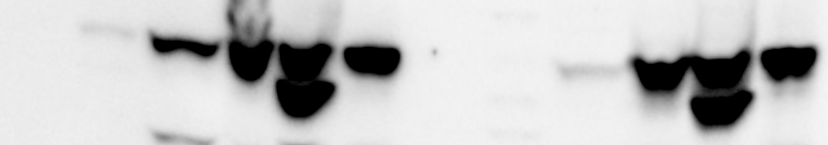

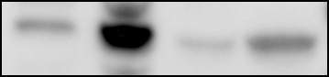
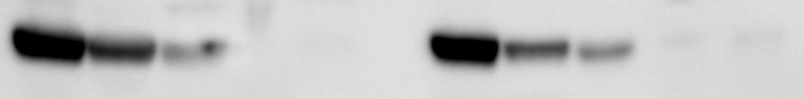
PFO extraction of cGAS test in THP-1 cells (wild type and rescue cell line)
THP-1 wt
THP-1 cGASKO_FG-cGAS
sup
pellet
sup
pellet
PBS
PFO
NP40
PBS
PFO
NP40
PBS
PFO
NP40
PBS
PFO
NP40
IB: cGAS
IB: MAVS
IB: ikba
RIPA_ext
hi-salt extract
S20
Pellet
IB: cGAS
IB: MAVS
IB: ikba
5-4-2016

Slide 2
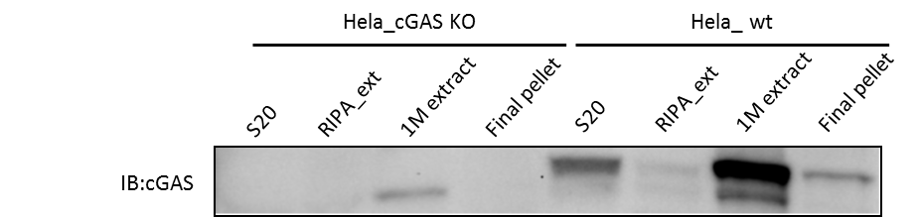
cGAS locates in the RIPA insoluble nuclear fraction
Hela_cGAS KO
Hela_ wt
RIPA_ext
1M extract
Final pellet
RIPA_ext
1M extract
Final pellet
S20
S20
IB:cGAS

Slide 3
Hela_GFP: No thymidine control
GFP
DAPI
Bright field
GFP/ DAPI

Slide 4
Hela_FG-GFP-cGAS: No thymidine control
GFP-cGAS
DAPI
Bright field
GFP-cGAS/ DAPI

Slide 5
Hela_FG-GFP-cGAS (treated with 100ng/ml Nocodazole for 12 hours)
GFP-cGAS
DAPI
Bright field
GFP-cGAS/ DAPI

Slide 6
Hela_GFP (treated with 100ng/ml Nocodazole for 12 hours)
GFP
DAPI
Bright field
GFP/ DAPI

Slide 7
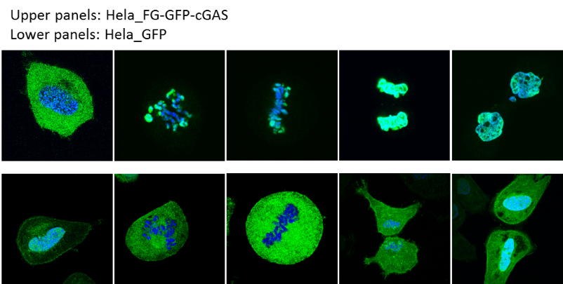
cGAS is translocated to the nucleus during cell cycle
Upper panels: Hela_GFP-cGAS
Lower panels: Hela_GFP
G1/S
Prometaphase
metaphase
Telophase
cytokinesis
Notes:
When the cells are arrested at G1/S/G2 phase for enough long time, the majority of the cGAS will be locating in the cytoplasm.

Slide 9
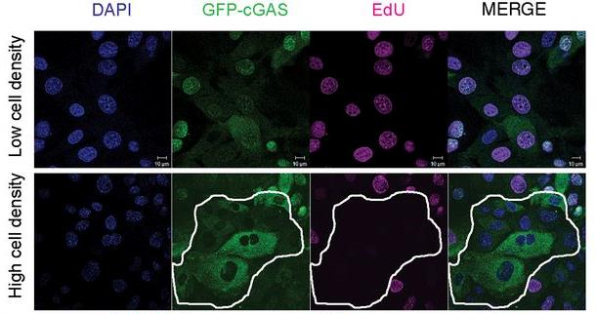
cGAS enters the nucleus in proliferating cells
Hui Yang et al. PNAS 2017;114:E4612-E4620

Slide 10
Summary_1
The localization of cGAS is dynamic with the stages of mitosis.
Majority of cGAS bind to chromosomes during cell division
cGAS is localized in the cytoplasm of non-dividing cells but enters the nucleus and associates with chromatin DNA during mitosis in proliferating cells.
Questions:
the cGAS bound to chromatin/chromosome active or not?

Slide 11
ISD transfection to control cells but not Nocodazole synchronized cells produced cGAMP

Slide 12
Test of cGAS activity in the nucleus
cGAS in the nucleus can be activated by ISD.

Slide 13
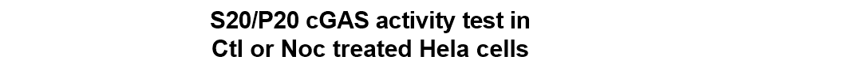
Test of cGAS activity in the Nocodazole treated cells

Slide 14
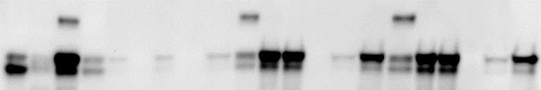
The localization of cGAS (soluble vs. insoluble)
S20 IP@0.4M (5ul)
0.5M ext IP@0.4M (5ul)
0.5M ext IP@1M (5ul)
0.1M Elu Eluates
0.1M Elu Eluates
0.1M Elu Eluates
0.1M Elu Beads
0.4M Elu Beads
0.1M Elu Beads
0.4M Elu Beads
0.1M Elu Beads
0.4M Elu Beads
0.5M extract
0.4M Elu Eluates
0.4M Elu Eluates
0.4M Elu Eluates
Pellet
IP Beads
IP Beads
IP Beads
S20
FT
FT
FT
IB: cGAS
cGAS population in S20 is different from cGAS in P20/1M extract, even after IP with 1M NaCl

Slide 15
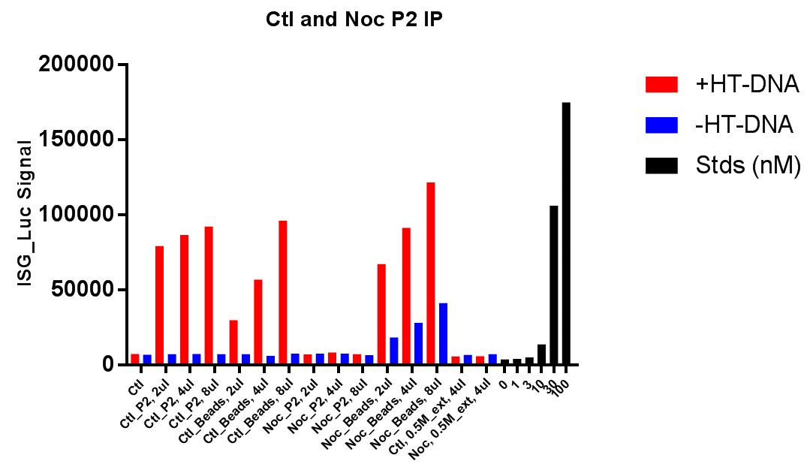
Nuclear fraction(pellet) from Nocodazole treated Hela cell does not have cGAS activity, however, after extraction and IP, the cGAS did have activity, which may exclude the possibility of modification on cGAS that regulates cGAS enzymatic activity.

Slide 16
Summary_2
In control cells (non-M phase cells, cGAS in the nucleus that is bound to chromatin is not activated by chromatin, but it can be activated by addition of ISD to it
When the cell is at M phase, most of cGAS protein is bound to the chromosomes, and at this stage, cGAS is not activated by chromosome and can not be activated by adding of ISD.
Questions:
We have indirect evidence to show that cGAS do bind to chromatin/chromosome through its DNA binding domain, however, what’s the regulation mechanism(s) that prevent cGAS from being activated?

Slide 17
Nuclear fraction(pellet) from Nocodazole treated Hela cell does not have cGAS activity, however, after extraction and IP, the cGAS did have activity, which may exclude the possibility of modification on cGAS that regulates cGAS enzymatic activity.

Slide 18
cGAS activity inhibition assay

Slide 19
3. Characterization and purification of cGAS inhibitor(s)
Inhibitor co-IPed with cGAS is heat resistant
IP-cGAS: IP-Flag-cGAS from 0.4M NaCl extract @ 0.4M NaCl, eluted with 1M NaCl, concentrated and buffer exchanged to 0.5M NaCl. (for 0.1ul and 0.3ul, use hypo to do 1:10 dilution first and use 1ul and 3ul, respectively)
IP-Ctl: Similar to 1 but IP from S20
Notes:
It makes sense that there should be a “real” inhibitor, but we really don’t want to see it’s heat sensitive, since it may indicate something not so good.

Slide 20
3. Characterization and purification of cGAS inhibitor(s)
Inhibitor co-IPed with cGAS is a protein
Notes:
Starting material are 1:5 diluted with hypo (final salt conc. is 100mM).
(for 0.1ul and 0.3ul, use hypo to do further 1:10 dilution first and use 1ul and 3ul, respectively)

Slide 22
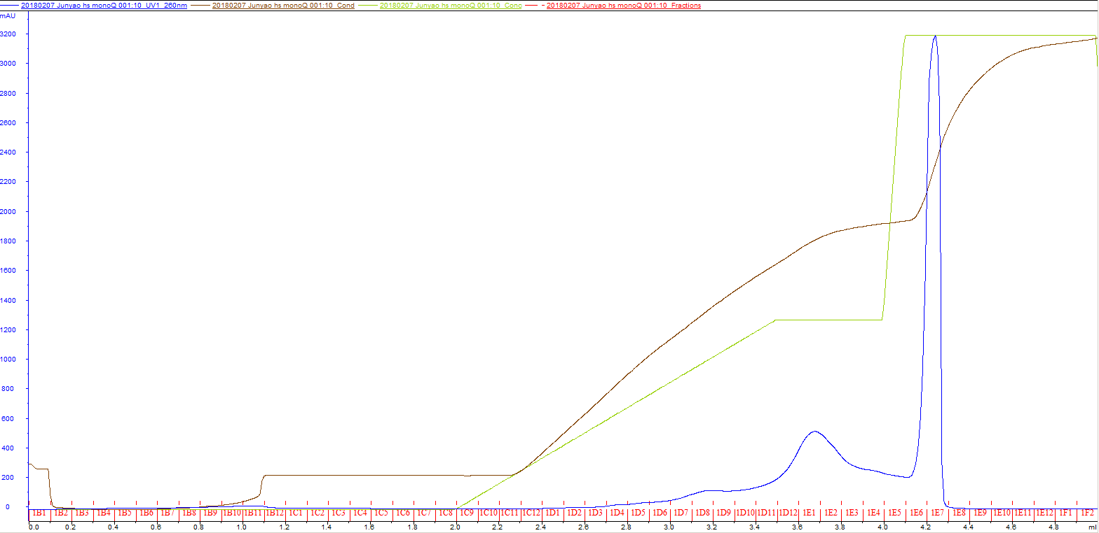
Heat soup on mono-Q column
Column: Mono-Q 0.1mL
Buffer A: 20mM Tris-HCl pH 7.5 + 0.1M NaCl
Buffer B: 20mM Tris-HCl pH 7.5 + 1M NaCl

Slide 24
BSA(ng)
10
50
100
D6
D7
D8
D9
D10
D11
D12
E1
E2
E3
E4
E5
E6
E7
250kd
150kd
100kd
75kd
50kd
37kd
25kd
20kd
15kd
10kd
Histone 2A?

Slide 25
3.5ng recombinant cGAS and 0.5ug chromatin for basal cGAS reaction (w/ RNase)

Slide 26
Heated H2B(ug)
H2B(ug)
Heated H2A(ug)
H2A(ug)
0.0625
1
0.0625
1
0.125
0.0625
0.0625
0.25
0.125
0.125
0.125
D10
1
0.5
0.25
0.25
0.25
0.5
1
0.5
0.5
250kd
150kd
100kd
75kd
50kd
37kd
25kd
20kd
15kd
10kd
After heating, about 50% of histone is gone, while 75% of H2A is gone
In terms of cGAS inhibitory activity, the D10 fraction from mono-Q is much stronger than purified histones (approximately 8x stronger than H2B and 16x stronger than H2A)
4ul D10 fraction is equivalent to 0.0625ug H2B, and previously, 1ul of D10 fraction can inhibit more than half of the cGAS activity, comparable to 0.125ug H2B.

Slide 27
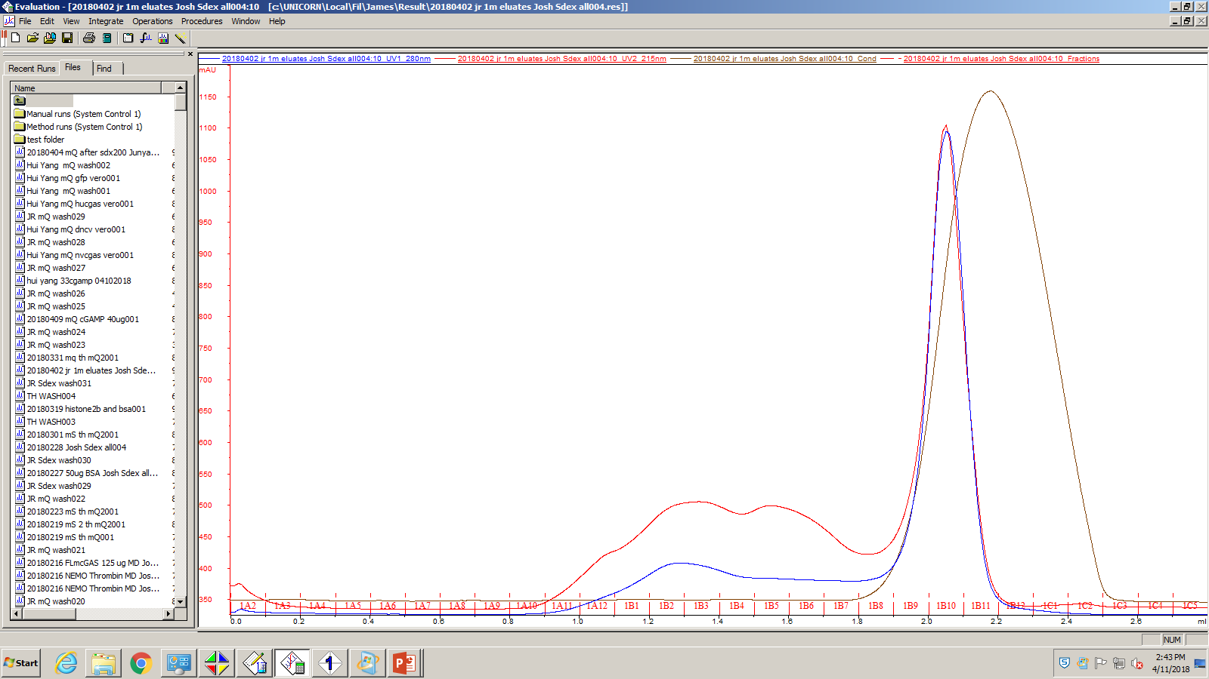

Slide 29
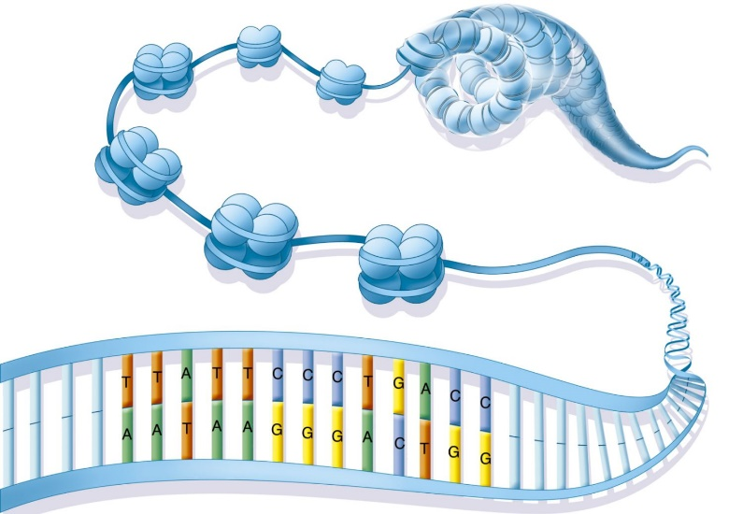
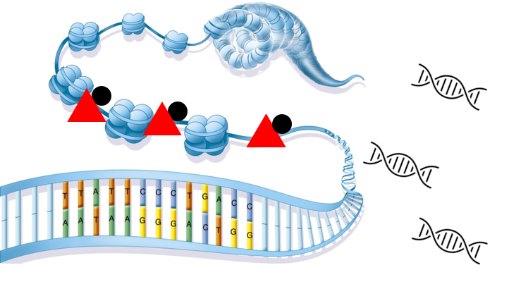

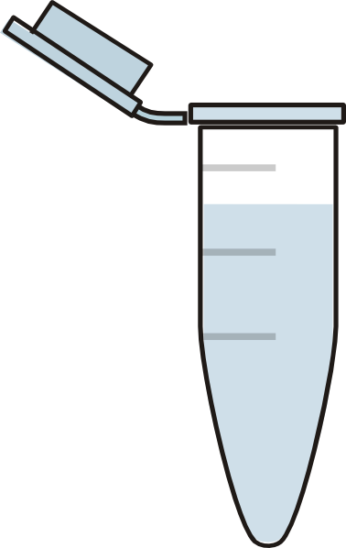
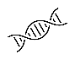
In high salt extraction
In reaction when we low the salt concentration
IP cGAS remove the putative inhibitor
cGAS
cGAMP
Putative inhibitor

Slide 30
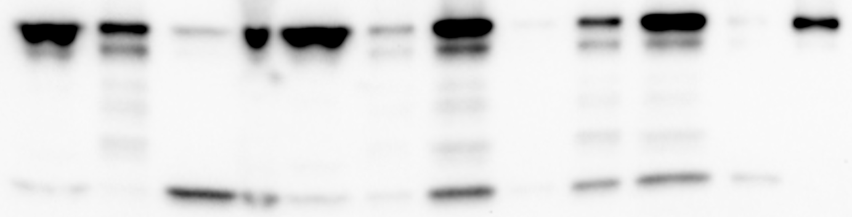
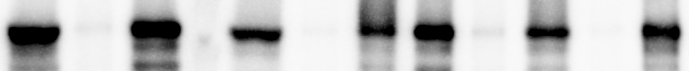
“factor(s)” in high salt extract from Hela_cGAS_KO cells precipitate cGAS at low salt
0.5M_ext+ hcGAS/TBK1
dilute to 0.1M
0.5M_ext+ hcGAS/TBK1
dilute to 0.5M
S20 + hcGAS/TBK1
P20 + hcGAS/TBK1
RIPA_ext+ hcGAS/TBK1
0.5M_ext + hcGAS/TBK1
20ng hcGAS/TBK1
sup
pellet
sup
pellet
sup
pellet
sup
pellet
sup
pellet
IB: cGAS
IB: TBK1

Slide 31
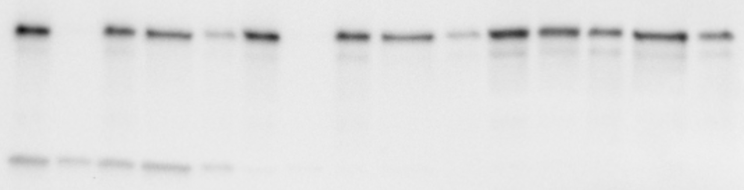
“factor(s)” in high salt extract from 293T cells precipitate cGAS at low salt
Hela_cGAS_KO 1M extract + hcGAS/TBK1 protein
293T 1M extract + hcGAS/TBK1 protein
293T S20 (w/ 1M NaCl) + hcGAS/TBK1 protein
Dilute to 0.1M
Dilute to 0.5M
Dilute to 0.1M
Dilute to 0.5M
Dilute to 0.1M
Dilute to 0.5M
total
sup
pellet
sup
pellet
total
sup
pellet
sup
pellet
total
sup
pellet
sup
pellet
IB: cGAS
IB: TBK1

Slide 32
Previous Summaries
cGAS binds chromatin in the nucleus;
At this status, cGAS is not activated by (intact) chromatin;
cGAS translocates into nucleus when nuclear membrane breaks down during cell cycle;
Chromatin bound cGAS can be activated by ISD
Here the cGAS activity of P2 is ISD dependent; however, this phenomenon is dependent on the integrity of the nucleus/chromoatin.

Slide 33
Previous Summaries
cGAS binds chromatin in the nucleus;
At this status, cGAS is not activated by (intact) chromatin;
cGAS translocates into nucleus when nuclear membrane breaks down during cell cycle;
Chromatin bound cGAS can be activated by ISD
During M phase, chromosome bound cGAS can NOT be activated by ISD

Slide 34
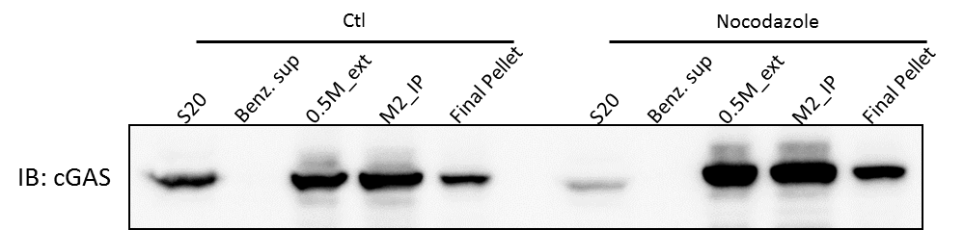
Previous Summaries
cGAS binds chromatin in the nucleus;
At this status, cGAS is not activated by (intact) chromatin;
cGAS translocates into nucleus when nuclear membrane breaks down during cell cycle;
Chromatin bound cGAS can be activated by ISD
During M phase, chromosome bound cGAS can NOT be activated by ISD
chromosome bound cGAS can be activated by ISD after IP

Slide 35
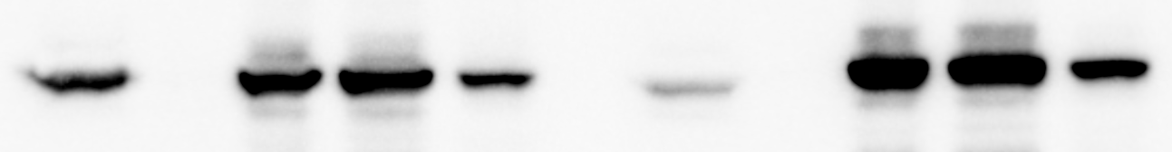
Ctl
Nocodazole
S20
Benz. sup
0.5M_ext
M2_IP
Final Pellet
S20
Benz. sup
0.5M_ext
M2_IP
Final Pellet
IB: cGAS

Slide 36
Previous Summaries
cGAS binds chromatin in the nucleus;
At this status, cGAS is not activated by (intact) chromatin;
cGAS translocates into nucleus when nuclear membrane breaks down during cell cycle;
Chromatin bound cGAS can be activated by ISD
During M phase, chromosome bound cGAS can NOT be activated by ISD
chromosome bound cGAS can be activated by ISD after IP
0.5M NaCl extract from nucleus (Ctl cells) inhibits cGAS activity

Slide 38
Forced nucleus translocation by GR-GR ligand interaction
293_STING_GFP-FG-GR_500
Non-treated
0.1uM Dexamethasone 3h
1.0uM Dexamethasone 3h
5.0uM Dexamethasone 3h
Notes:
As fast as 30min

Slide 39
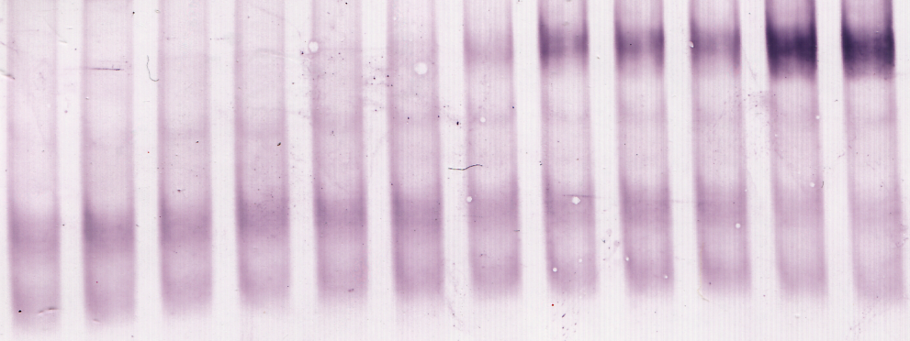
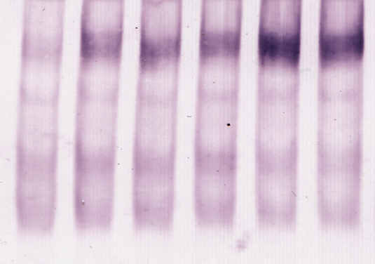
Forced nucleus translocation by GR-GR ligand interaction
cGAS nuclear translocation activates cGAS/STING/TBK1/IRF3 pathway
1 | 2 | 3 | 4 | 5 | 6 | 7 | 8 | 9 | 10 | 11 | 12
293_ST_GFP-FG-GR_500 |  |  |  |  |  | 293_ST_cGAS-FG-GR_30
- | - | - | - | + | + | - | - | - | - | + | +
- | 0.1 | 1.0 | 5.0 | 0 | 1.0 | - | 0.1 | 1.0 | 5.0 | 0 | 1.0
13 | 14 | 15 | 16 | 17 | 18
293_ST_cGAS-FG-GR_100
- | - | - | - | + | +
- | 0.1 | 1.0 | 5.0 | 0 | 1.0
Cell line
HT-DNA(6μg)
Dexamethasone (μM)
IB: hIRF3
The number (30, 100 or 500) at the end of the cell line indicates the volume of lentivirus (μL) used for stable cell line establishment, which determines the expression level of the protein (GFP or cGAS)
Translocation occurs as soon as 30min after Dex treatment (indicated by GFP signal)

Slide 40
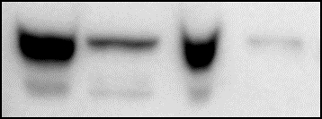

Forced nucleus translocation by GR-GR ligand interaction
Ctl
Dex
Nu
Cyto
Nu
Cyto
IB: FG-cGAS
293_STING_cGAS-FG-GR_100
IB: FG-GFP
293_STING_GFP-FG-GR_500
Even with GR ligand binding domain tag, most cGAS still reside in the nucleus
Adding of GR ligand (Dexamethasome) promote a little bit more cGAS into the nucleus
Notes:
GR tag: 30kd 268aa

Slide 41
Forced nucleus translocation by GR-GR ligand interaction

